Slide 1
Crypto Trends Analyzer
CS584 MACHINE LEARNING
Professor: Oleksandr Narykov
Group
Tirth Patel (A20547799)
Het Ranpura (A20550582)
Devendra Singh Portey (A20538603)

Slide 2

Problem Statement
Cryptocurrencies, like Bitcoin, are types of money that can be traded online and their prices change a lot. They are very popular with young people who want to invest money. Because the prices can go up and down very quickly, it can be hard for people to decide if they should invest in them. Sometimes, even a little bit of news on social media can make the price of Bitcoin go up or down a lot. This project will try to use special computer programs to guess the future price of Bitcoin to help investors make more money.

Slide 3
Project Description
The Crypto Trends Analyzer project uses machine learning to try and guess the future price of Bitcoin.
Bitcoin's price changes a lot and can be hard to predict because many things can affect it, like how much people want to buy or sell, what people think will happen, news stories, and new rules from governments.
The hard part of making a computer model to guess Bitcoin's price is figuring out which things really change the price and making a model that can predict these changes well.
To do this, you need to gather a lot of past data about Bitcoin's prices, choose the right data points and computer methods, and make sure the model works by testing and improving it.

Slide 4
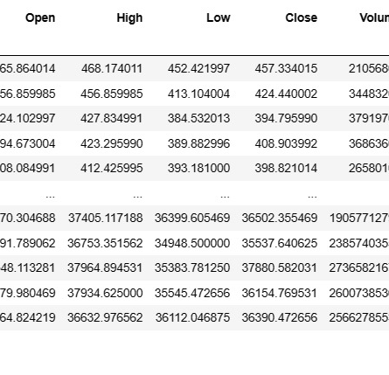
Data Collection and Preparation
Collect important information about Bitcoin's price and other things that affect it, like how much is traded, how much it's worth in total, and how people are feeling about it.
Make the information clean and complete by getting rid of errors or gaps, so it can be used in computer programs that are designed to learn and make predictions.

Slide 5
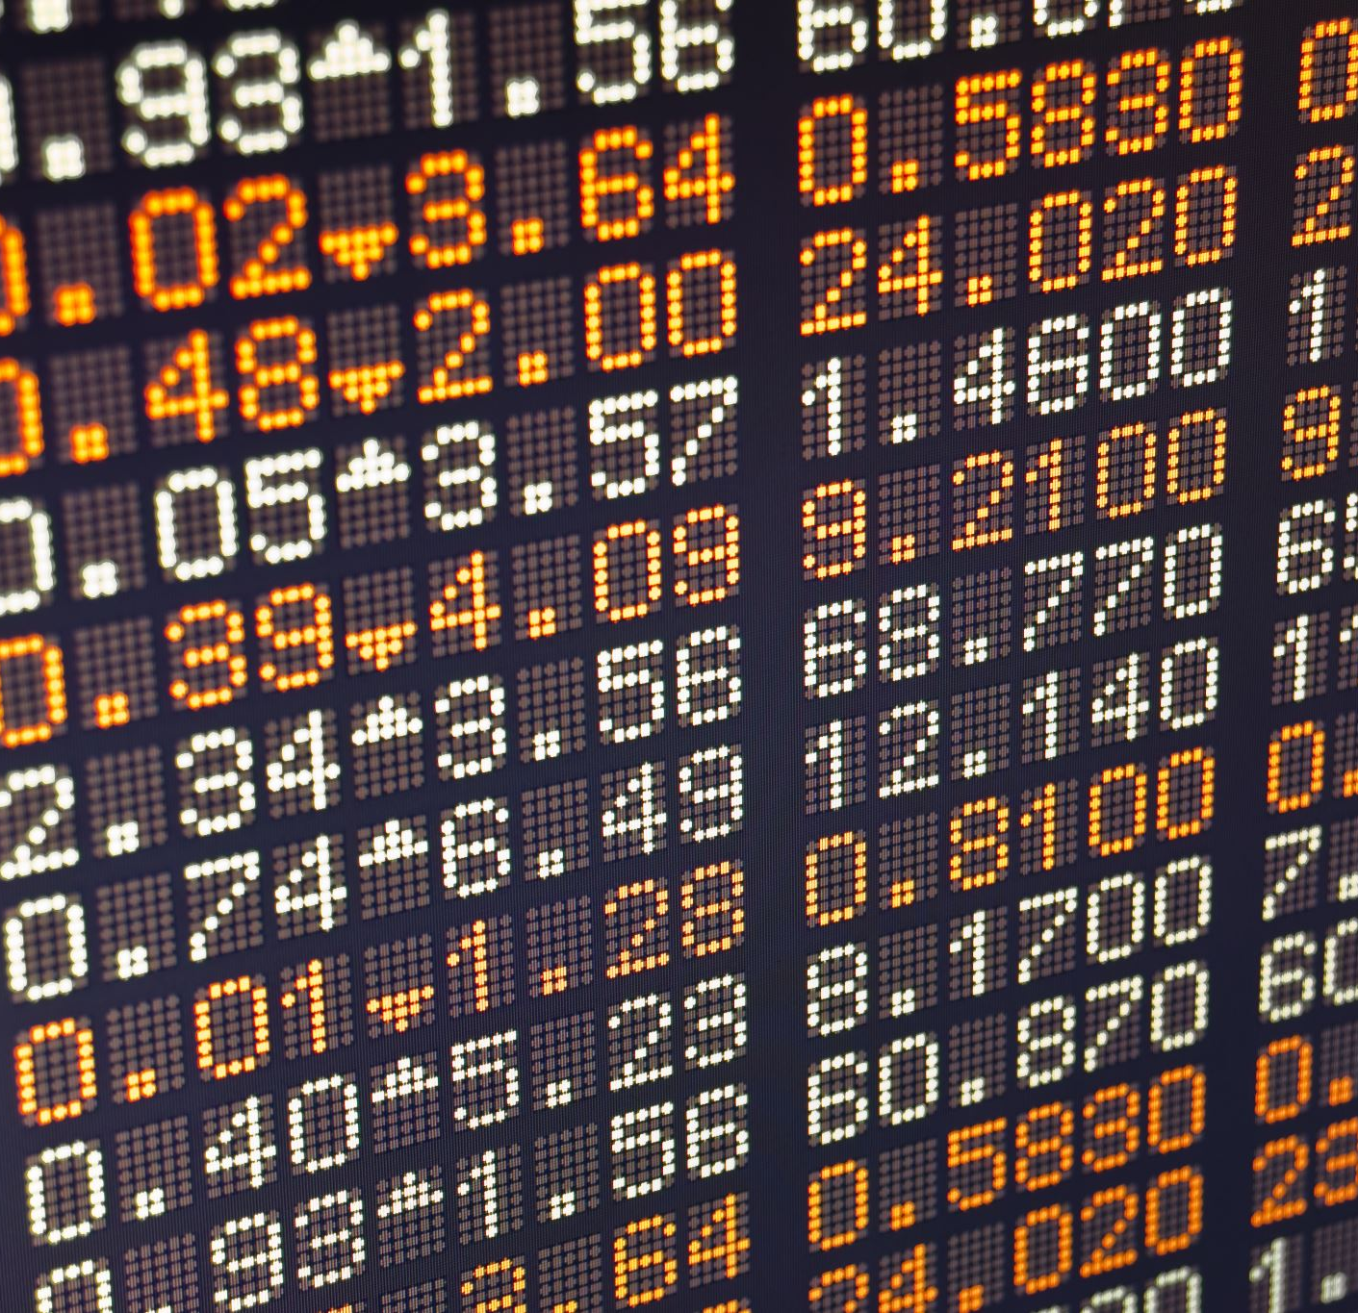
Explanation of the Data collected
Here's a simple explanation of the information used in the project:
Date: The day the information was recorded.
Open: The price of Bitcoin at the start of the day.
High: The highest price Bitcoin reached that day.
Low: The lowest price Bitcoin was at that day.
Close: The price of Bitcoin at the end of the day.
Volume: How much Bitcoin was traded throughout the day.
Market Cap: The total worth of all Bitcoin available.

Slide 6
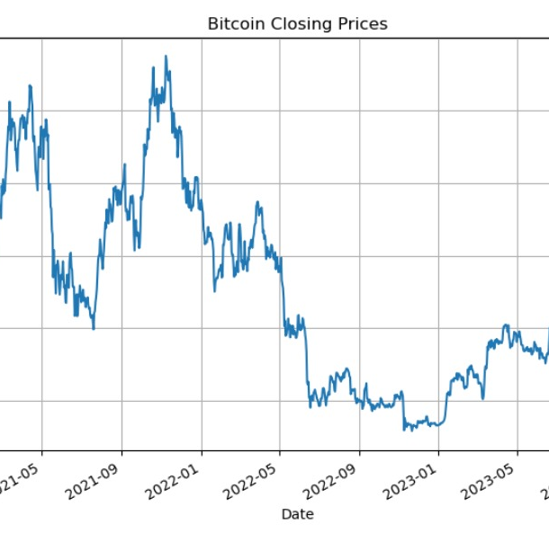
Time Series Data Visualization

Slide 7
Choosing the Best Model
AR
MA
ARIMA
LINEAR, LASSO,
MULTI-PERCEPTRON,
RANDOM FOREST
Random Forest
Linear Regression

Slide 8
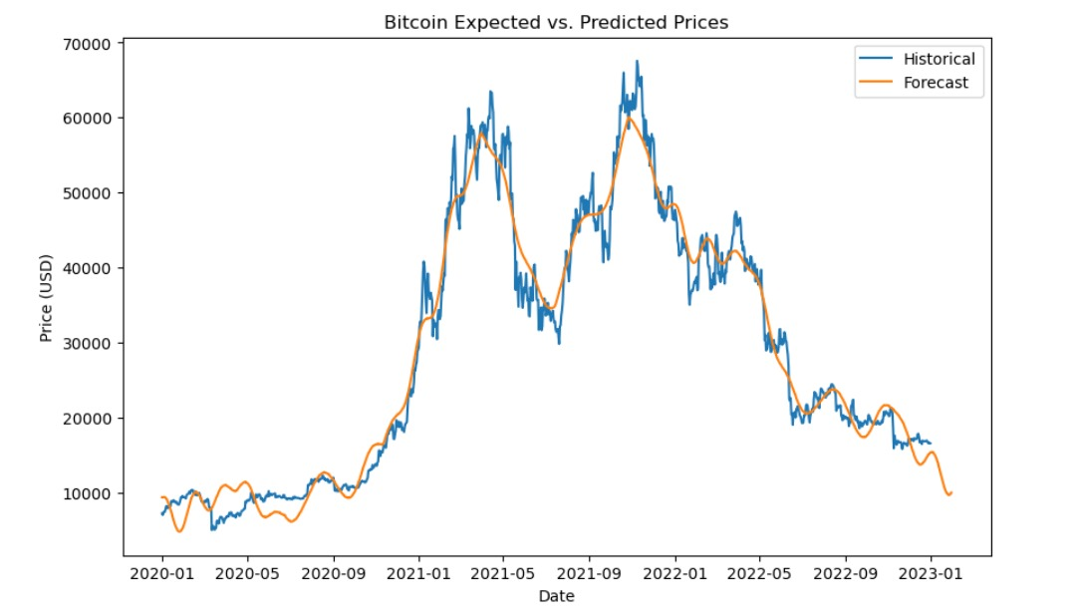
Our model seems to do well on the test data.

Slide 9

Conclusions and Future Work
To make our predictions better, we can do things like adding new features to our data or increasing our data in smart ways. We can also include information about how people feel about Bitcoin. Plus, we can try using different types of computer models, like ones that make predictions, sort things into groups, or even use complex brain-like networks.

Slide 10
THANK YOU

